Slide 1

April 14th, 2023 Hong Kong
LayerTwo Labs – A Drivechain Company
Paul Sztorc Creator: BIsPs 300/301 ; truthcoin.info Presenter: Scaling Bitcoin I-IV, MIT Bitcoin Club, Bitcoin 2019-2023, Baltic Honeybadger, etc.
CryptAxe Bitcoin Core Dev: 0.14, 0.15, 0.16. Infrastructure engineer: BIPs 300/301. Creator: sidechain template, DeFi/BitAsset sidechain.
Austin Alexander Sales & Biz Dev @ Kraken (2014-2022) CEO @ Kraken MENA (2019 -2021) Co-Founder @ Bitcoin Center NYC (2013)
Nikita Chashchinskii Creator of the zCash Sidechain, Bip300 Bridge Module, EVM Sidechain, & switchboard launcher.

Slide 2

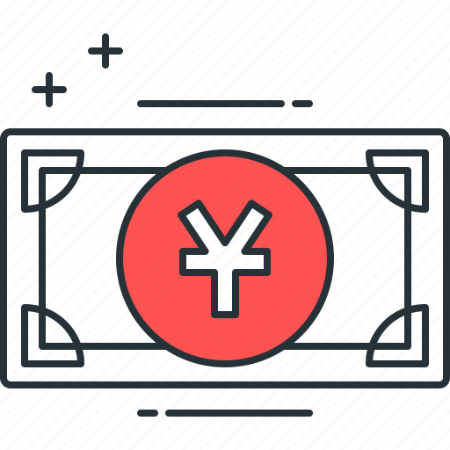

Everything on Top of Bitcoin
zCash
FileCoin
ETH
VISA
WeChat Pay
ETH
zCash
FileCoin
BTC Today
WeChat Pay
VISA
BTC + Drivechain
Today ☹
Tomorrow ☺
Notes:
6

Slide 3
Everything on Top of Bitcoin
zCash
FileCoin
ETH
VISA
WeChat Pay
ETH
zCash
FileCoin
BTC Today
WeChat Pay
VISA
BTC + Drivechain
Today ☹
Tomorrow ☺
Notes:
6

Slide 4
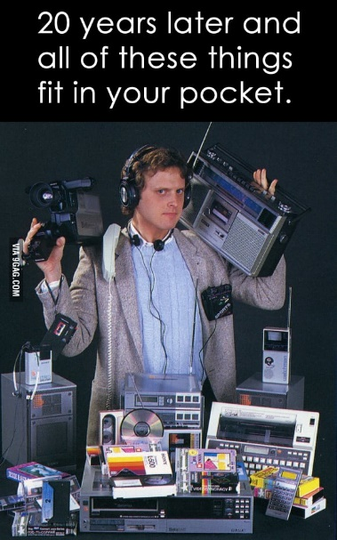


The Coming Death of Bitcoin’s Competitors
WeChat Pay
VISA
ETH
BTC Today
zCash
BTC + Drivechain
FileCoin

Slide 5
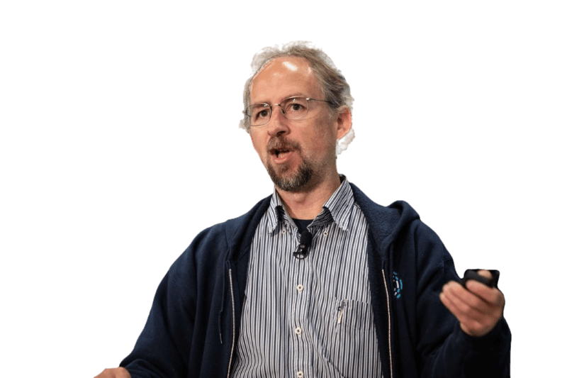

“
“
Drivechain arguably more useful than Taproot.
Drivechain is our only hope. ... We need Drivechain or all the work of thousands in the last 13 years will be in vain.
Adam Back, Founder of Blockstream
Fiatjaf, Creator of Nostr

Slide 6
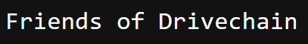
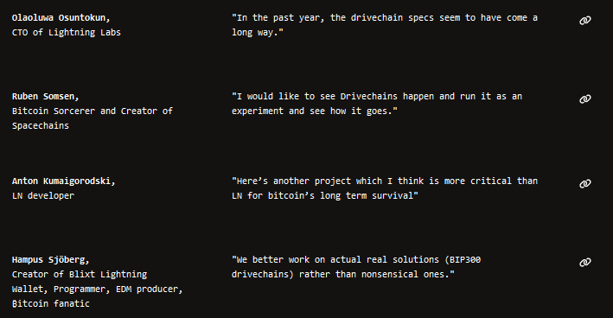
visit LayerTwoLabs.com for more

Slide 7
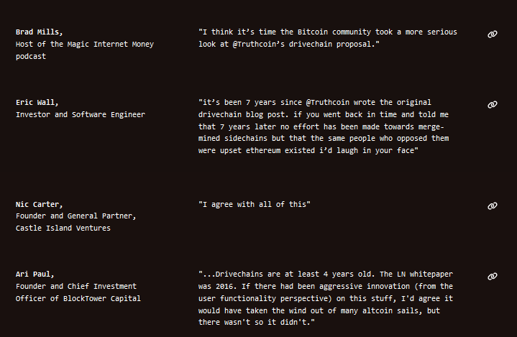
visit LayerTwoLabs.com for more

Slide 8
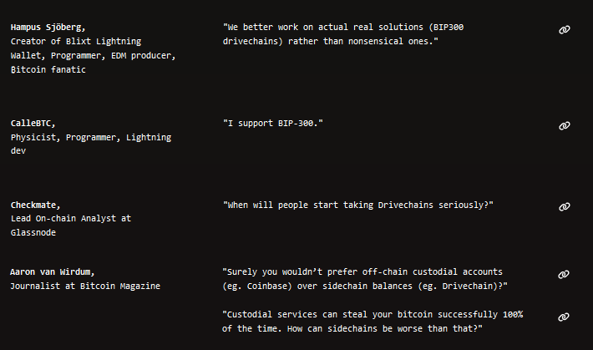
visit LayerTwoLabs.com for more

Slide 9
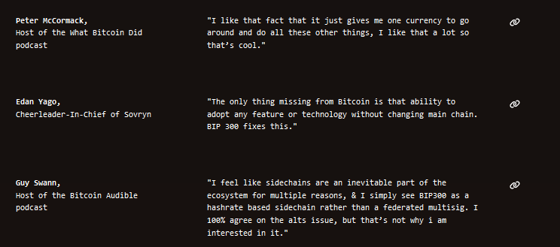
visit LayerTwoLabs.com for more

Slide 10
How it Works
= Block Header
= List of transactions
December 2020
January 2021
February 2021
March 2021
April 2021
Base Layer (Bitcoin Core)
Notes:
Two blockchains, (main and side), The sidechain has 3 month epochs with are defined by one hash.
There is an arrow from the hash to the layer1 coinbase txn, denoting the insertion

Slide 11
How it Works
= Block Header
= List of transactions
December 2020
January 2021
February 2021
March 2021
April 2021
Layer 2 (Bit-Monero)
Base Layer (Bitcoin Core)
Notes:
Two blockchains, (main and side), The sidechain has 3 month epochs with are defined by one hash.
There is an arrow from the hash to the layer1 coinbase txn, denoting the insertion

Slide 12
How it Works
= Block Header
= List of transactions
December 2020
January 2021
February 2021
March 2021
April 2021
Layer 2 (Bit-Monero)
e320
81cd
3 Months = One 32-byte Hash
3 Months = One 32-byte Hash
e320b6c2fffc8d750423db8b1eb942ae710e951ed797f7affc8892b0f1fc122b
81cd02ab7e569e8bcd9317e2fe99f2de44d49ab2b8851ba4a308000000000000
Base Layer (Bitcoin Core)
e320 ... Pays Out
Notes:
Two blockchains, (main and side), The sidechain has 3 month epochs with are defined by one hash.
There is an arrow from the hash to the layer1 coinbase txn, denoting the insertion

Slide 13
Your Layer1 Node, Sees...
= Block Header
= List of transactions
December 2020
January 2021
February 2021
March 2021
April 2021
Base Layer (Bitcoin Core)
e320b6c2fffc8d750423db8b1eb942ae710e951ed797f7affc8892b0f1fc122b
e320 ... Pays Out
81cd02ab7e569e8bcd9317e2fe99f2de44d49ab2b8851ba4a308000000000000
Notes:
Two blockchains, (main and side), The sidechain has 3 month epochs with are defined by one hash.
There is an arrow from the hash to the layer1 coinbase txn, denoting the insertion

Slide 14
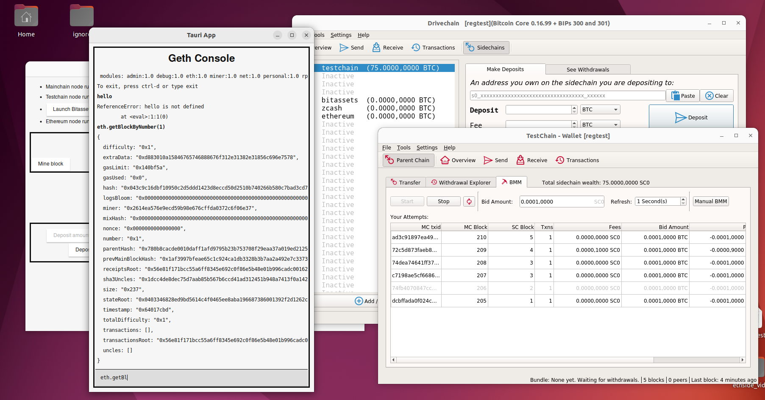
Try Our Software -- see for yourself!

Slide 15
Try Our Software -- see for yourself!
Bitcoin Core (smartphone)
Ethereum-Drivechain (music app, Replaces the CD)
Another Drivechain
Notes:
A Bip300 sidechain , is an Altcoin without a new coin.

Slide 16
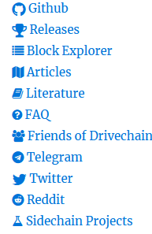
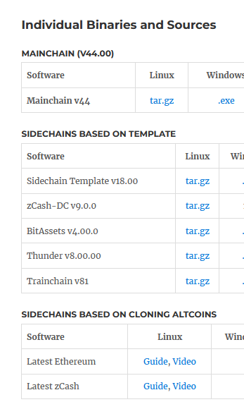
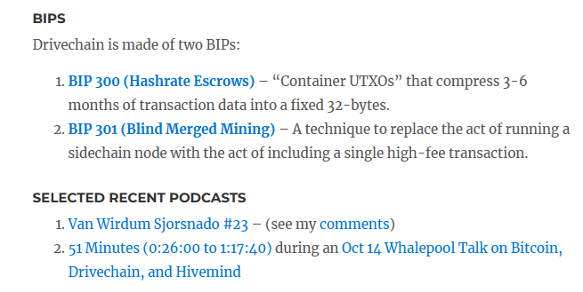
drivechain.info
Six years of:
Slides
Me as a Podcast Guest
Technical Documentation
Software
Endorsements
Peer Review
FAQ
Memes

Slide 17
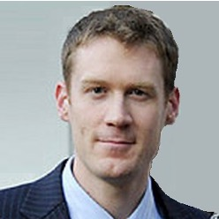
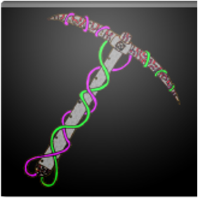
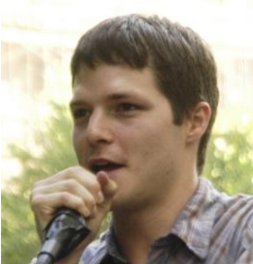

TEAM
Austin Alexander
Nikita Chashchinskii
Paul Sztorc
CryptAxe
Creator of BIPs 300/301, Bitcoin Consultant & Presenter (Scaling Bitcoin, Bitcoin 2019/2021/2022, Consensus NYC, TABconf, Qcon etc). Fmr Software Engineer @ Yale Econ dept (2012 - 2015).
Bitcoin Core developer (2016-Present; 0.14, 0.15, 0.16). Infrastructure engineer BIPs 300/301. Creator of sidechain template, BitAsset sidechain, zCash sidechain GUI.
Kraken - Business development (2014-2022) *Kraken MENA - CEO (2019-2021) *NYC Bitcoin Center - co-founder (2013-2014)
Creator of the zCash Sidechain, Bip300 Bridge Module, & EVM Sidechain.

Slide 18
TEAM
Each 10+ Years Bitcoin Experience
Austin Alexander
Nikita Chashchinskii
Paul Sztorc
CryptAxe
Creator of BIPs 300/301, Bitcoin Consultant & Presenter (Scaling Bitcoin, Bitcoin 2019/2021/2022, Consensus NYC, TABconf, Qcon etc). Fmr Software Engineer @ Yale Econ dept (2012 - 2015).
Bitcoin Core developer (2016-Present; 0.14, 0.15, 0.16). Infrastructure engineer BIPs 300/301. Creator of sidechain template, BitAsset sidechain, zCash sidechain GUI.
Kraken - Business development (2014-2022) *Kraken MENA - CEO (2019-2021) *NYC Bitcoin Center - co-founder (2013-2014)
Creator of the zCash Sidechain, Bip300 Bridge Module, & EVM Sidechain.

Slide 19
The Benefits
The 21M coins, can travel to/from other blockchains. Or stay on L1.
Blockchains become sort of like optional plug-ins. One à la carte super-coin.
Investors:
Technical innovation never threatens your coin-investment.
All investors united in one team, against fiat.
No need to “fund development” – just copy other’s code.
Safely ignore all technical squabbles, & enjoy all innovation.
Development:
Devs do as they like, no bureaucracy.
Users switch blockchains like switching from Chrome to Firefox. Can “fire” / “hire” devs at will.
Each dev is CEO/dictator of their own private realm, accountable only to their customers/users (who can leave at any time). Perfect incentive alignment.
Users:
Get every feature of every crypto-coin. (Plus: no gas fees.)
Competition ensures rapid progress on whatever problem du jour – MEV, Censorship, etc.
Culture no longer rewards toxicity – there is no need to feel threatened by change/novelty.
Rewards creativity & innovation, instead of stasis & defense.
Miners:
Collect all fees from all blockchain transactions everywhere, while doing zero additional work.
Ensures maximum security budget, with minimal per-txn fees, and no violations of 21M coin limit.

Slide 20
Our Goals
BTC gets immediate global scale & unbreakable privacy.
Fees (on “per txn” basis) are always near-zero.
Miner revenues grow exponentially, forever.
L1 never changes again – maximum decentralization, zero bickering.
Immediate, total creative freedom for devs – no lobbying, no toxicity.
End of scam coins, scam marketing (& other distractions).
Devs make useful blockchains – no to Ponzi-nomics, yes to coin-use.
NameCoin -- Revolution in Media / Free Speech / Social Media.
Prediction Markets – Prevent CEOs/Politicians from lying, double wGDP_g
All this with zero risk to Bitcoin – 100% optional & reversible.
Our investors make an excellent ROI.

Slide 21
Our Goals
BTC gets immediate global scale & unbreakable privacy.
Fees (on “per txn” basis) are always near-zero.
Miner revenues grow exponentially, forever.
L1 never changes again – maximum decentralization, zero bickering.
Immediate, total creative freedom for devs – no lobbying, no toxicity.
End of scam coins, scam marketing (& other distractions).
Devs make useful blockchains – no to Ponzi-nomics, yes to coin-use.
NameCoin -- Revolution in Media / Free Speech / Social Media.
Prediction Markets – Prevent CEOs/Politicians from lying, double wGDP_g
All this with zero risk to Bitcoin – 100% optional & reversible.
Our investors make a fortune.

Slide 22
The Last Slide!
Nov 2015
“Drivechain” blog post written
Jan 2017
Drivechain.info created
Feb 2018
Assigned BIP #s (300/301)
Mar 2019
1st Bip300 sidechain
June 2021
zCash sidechain
May 2022
4 sidechains total
June 2022
Eth Sidechain (5th sidechain)
May 2022
Gather co-founders, Retain Fenwick, Incorporate, 409A Valuation
Sept 2022
$3M seed for product, legal, overhead, basic marketing.
Apr 2023
Second (and FINAL) round of Fundraising

Slide 23
END Thank You
visit LayerTwoLabs.com Drivechain.info for more
Paul Sztorc
@truthcoin on Twitter
@psztorc on Telegram

Slide 24



Bitcoin
Why Bip300
The Payments Spectrum
Extensibility
Very decentralized.
Decently private.
Somewhat low on extensibility.
BTC
One coin, one blockchain
Privacy
Centralization

Slide 25









Altcoins
Why Bip300
The Payments Spectrum
Extensibility
ETH
BSC
ADA
SOL
DOT
Privacy
Rival coins -- different protocol, different blockchain
ZEC
XMR
300 kb Bitcoin
BTC
BCH
BSV
Centralization

Slide 26

Bip300
One Coin, Many Blockchains
Extensibility
ETH
BSC
ADA
SOL
DOT
Privacy
ZEC
Allows BTC to Cover
the Entire Spectrum of Use-Cases
XMR
300 kb Bitcoin
BTC
BCH
BSV
Centralization

Slide 27


Fiat
Also Copy Non-Blockchain Systems
Cash
Banking
Non-blockchain, centralized…
Extensibility
Privacy
Centralization

Slide 28
Bip300
One Coin, Entire Payments Spectrum
Cash
Banking
…just more for Bip300 to copy!
Extensibility
Privacy
Centralization

